Slide 1

UC Berkeley
Gym Attendance
Analysis
Jeff Ernst
April 2017

Slide 2

Analysis Goals
Explore Trends
Explore Trends
Explore Trends
Explore Trends
Explanation
UC Berkeley Gym Attendance Analysis
2

Slide 3

Analysis Goals
Explore Trends
Predict Attendance
Explore Trends
Explore Trends
Explanation
UC Berkeley Gym Attendance Analysis
3

Slide 4


Analysis Goals
Explore Trends
Predict Attendance
Create Model
Create Application
Explanation
UC Berkeley Gym Attendance Analysis
4

Slide 5
Analysis Goals
Explore Trends
Predict Gym Attendance
Explore Variable Relationships through ...
Analysis Goals
Data Overview
Variable
Relationships
Model
Results
5

Slide 6





Data Overview
Predictors
Target
School
Holiday
Climate
Date / Time
Gym Attendance
Semester #
Major Holiday
Temperature
Day of Week
During Semester
Precipitation
Hour
Holiday Recess
Start of Semester
Academic Holiday
Week of Semester
UC Berkeley Gym Attendance Analysis
6

Slide 7
Analysis Goals
Explore Trends
Predict Attendance
Create Model
Create Application
In order to use our results, we create an application for users
In order to use our results, we create an application for users
In order to use our results, we create an application for users
In order to use our results, we create an application for users
UC Berkeley Gym Attendance Analysis
7

Slide 8


Timing is Everything
Weekend Wasteland
Evening Rush
Gym attendance is typically 28% lower on the weekend versus a typical weekday
The gym is generally the most crowded between the hours of 4pm and 10pm
UC Berkeley Gym Attendance Analysis
8

Slide 9
Timing is Everything
UC Berkeley Gym Attendance Analysis
9

Slide 11
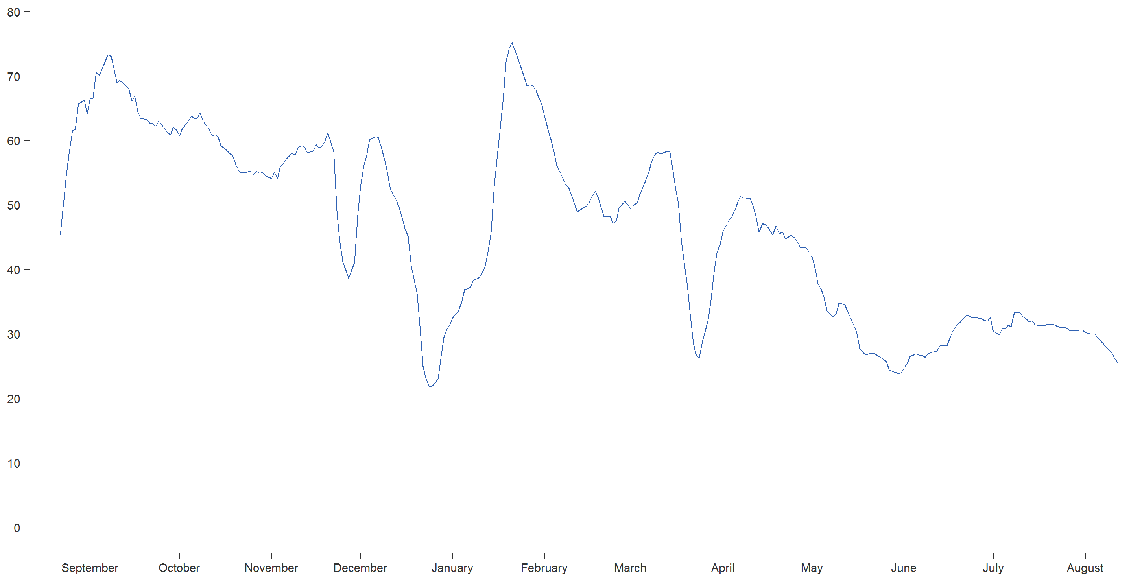
UC Berkeley 2015-16 Gym Attendance
Number of People
(7-day Moving Average)
Month

Slide 12
UC Berkeley 2015-16 Gym Attendance
School Begins
Aug 26, 2016
Every freshman is in the gym until next week
Number of People
(7-day Moving Average)
Month

Slide 13
UC Berkeley 2015-16 Gym Attendance
School Begins
Aug 26, 2016
Every freshman is in the gym until next week
Number of People
(7-day Moving Average)
Thanksgiving
Nov 26 2015
Working out is optional when you’re filling up on turkey and mashed potatoes
Month

Slide 14
UC Berkeley 2015-16 Gym Attendance
School Begins
Aug 26, 2016
Every freshman is in the gym until next week
Number of People
(7-day Moving Average)
Thanksgiving
Nov 26 2015
Working out is optional when you’re filling up on turkey and mashed potatoes
Winter Break
Dec 19-Jan 19, 2015
Most students head home for the winter holidays, like Christmas and Hanukkah
Month

Slide 15
UC Berkeley 2015-16 Gym Attendance
School Begins
Aug 26, 2016
Every freshman is in the gym until next week
New Year’s Gym Rush
Jan 20, 2016
Students flood to the gym in a futile attempt to fulfill their New Year’s goals
Number of People
(7-day Moving Average)
Thanksgiving
Nov 26 2015
Working out is optional when you’re filling up on turkey and mashed potatoes
Winter Break
Dec 19-Jan 19, 2015
Most students head home for the winter holidays, like Christmas and Hanukkah
Month

Slide 16
UC Berkeley 2015-16 Gym Attendance
School Begins
Aug 26, 2016
Every freshman is in the gym until next week
New Year’s Gym Rush
Jan 20, 2016
Students flood to the gym in a futile attempt to fulfill their New Year’s goals
Number of People
(7-day Moving Average)
Thanksgiving
Nov 26 2015
Working out is optional when you’re filling up on turkey and mashed potatoes
Winter Break
Dec 19-Jan 19, 2015
Most students head home for the winter holidays, like Christmas and Hanukkah
Spring Break
Mar 21-25, 2016
Spring break! Party! Woo!
Month

Slide 17
UC Berkeley 2015-16 Gym Attendance
School Begins
Aug 26, 2016
Every freshman is in the gym until next week
New Year’s Gym Rush
Jan 20, 2016
Students flood to the gym in a futile attempt to fulfill their New Year’s goals
Number of People
(7-day Moving Average)
Spring Commencement
May 14, 2016
The gym becomes an empty wasteland until next year
Thanksgiving
Nov 26 2015
Working out is optional when you’re filling up on turkey and mashed potatoes
Winter Break
Dec 19-Jan 19, 2015
Most students head home for the winter holidays
Spring Break
Mar 21-25, 2016
Spring break! Party! Woo!
Month

Slide 18
UC Berkeley 2015-16 Gym Attendance
School Begins
Aug 26, 2015
Every freshman is in the gym until next week
New Year’s Gym Rush
Jan 20, 2016
Students flood to the gym in a futile attempt to fulfill their New Year’s goals
Number of People
(7-day Moving Average)
Spring Commencement
May 14, 2016
The gym becomes an empty wasteland until next year
Thanksgiving
Nov 26 2015
Working out is optional when you’re filling up on turkey and mashed potatoes
Winter Break
Dec 19-Jan 19, 2015
Most students head home for the winter holidays
Spring Break
Mar 21-25, 2016
Spring break! Party! Woo!
Month

